Slide 1
APOLOGETICS
IN ONE LESSON
almost
Ai1L.net
Lesson 6
Eyewitness Memory

Slide 2
Key Takeaways (review)
1
Gospels are ancient biographies which expected living eyewitnesses
2
The New Testament valued living eyewitness sources (and named them)
3
The early church valued living eyewitness sources (and could name them)

Slide 3
IDEA IN BRIEF
What?
Show that the memories of the eyewitnesses can be trusted
Why?
Because the gospel message was transmitted orally before it was written down
How?
By establishing:
The attributes of what makes a memory memorable
That the Gospel accounts include many of these memories

Slide 4
New Testament Timeline
Galatians, 1 Thessalonians, Romans
Philemon, 1-2 Corinthians
+20-30 years
Undisputed Epistles
Jesus’ Life
Gospels recorded
Paul becomes a Christian ¹
0 AD
+2 years
50 AD
100 AD
Gospels as oral history
¹ | Acts 9:18

Slide 5
“there were two sorts of oral histories and oral traditions.”
JAN VANSINA African Studies Quarterly Volume 18, Issue 2 February 2019 (page 15)

Slide 6
“Oral histories about recent times,
from interviews,
which may go back to about hundred and twenty years ago”
JAN VANSINA African Studies Quarterly Volume 18, Issue 2 February 2019 (page 15)

Slide 7
“There is no problem left. And they can be used anywhere in the world.”
JAN VANSINA African Studies Quarterly Volume 18, Issue 2 February 2019 (page 15)

Slide 8
What makes memories … memorable
1
Is a unique or unusual event
2
Is an important or consequential event
3
Is an event in which the person is emotionally involved
4
It includes vivid imagery
5
Are frequently repeated or rehearsed

Slide 9
“Remember that it is not memory for the central newsworthy event that constitutes a FB memory, but rather memory for the circumstances in which one first heard the news”
BROWN & KULIK “Flashbulb Memories.” Cognition, vol. 5, no. 1, 1977, pp. 95

Slide 10
Likelihood to Remember after 50 years
Comparing people who were in the events vs. those taught

Slide 11
“God is dead. God remains dead. And we have killed him. How shall we comfort ourselves, the murderers of all murderers? What was holiest and mightiest of all that the world has yet owned has bled to death under our knives: who will wipe this blood off us? What water is there for us to clean ourselves?”
ROBERT K. MCIVER Memory, Jesus, and the Synoptic Gospels (page )

Slide 12
First Century Survival Rates
Percent of people who would still be living 25 years later
Notes:
This looks at the percent of people who would still be alive at +25y e.g. 30% of 10 year olds people would still be alive 25 years later

Slide 13
Surviving Witness Pool
Number of the 500 would still be living when 1 Cor. 15 was written
`
1 Corinthians was written in 53-57 AD and Jesus died around 33 AD (roughly 20-25 years later)
Number of the 500 resurrection witnesses still living (assuming the witnesses were 15 years old or older)
Notes:
This looks at the number of the 500 people who would still be alive at +25y e.g. 190-241 of the 500 would be alive at the time of the writing of 1 Corinthians assuming that the witnesses were greater than15 year when they were witnesses

Slide 14
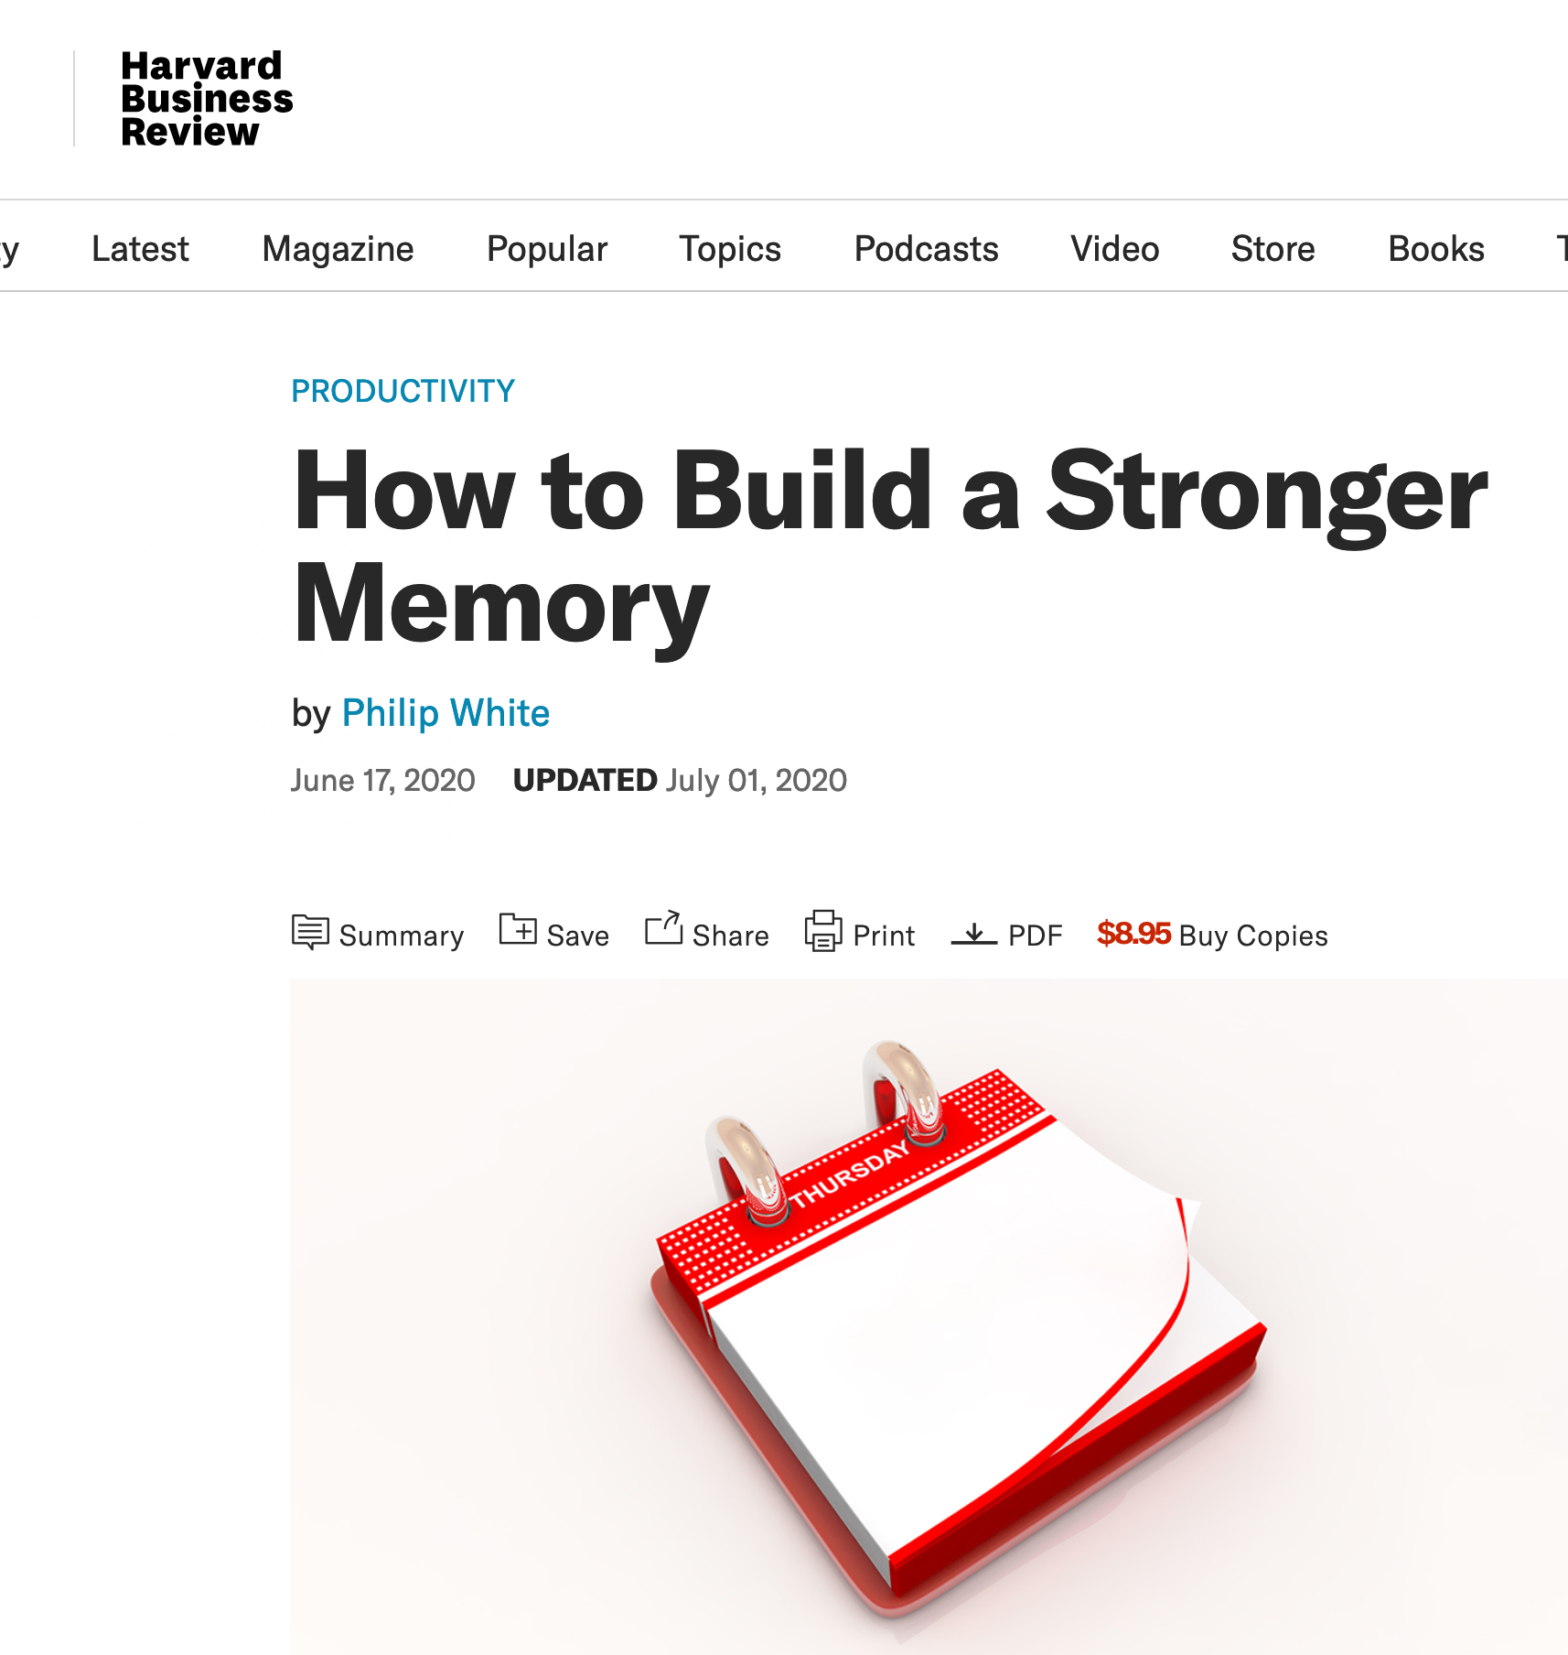
“Smartphones have been shown to harm the brain’s ability to retain important details…”
PHILIP WHITE How to Build a Stronger Memory

Slide 15
“You are not training your memory to recall information. Rather, you are training it to rely on external tools that can do so for you.”
PHILIP WHITE How to Build a Stronger Memory

Slide 16
Key Takeaways
1
Events are likely to be remembered if they are: 1. Consequential
2. Vivid
3. Emotional
4. Unique 5. Rehearsed
2
The Gospel accounts include many of these events would be memorable
3
Known memory limitations cannot adequately provide an alternate explanation

